Slide 1
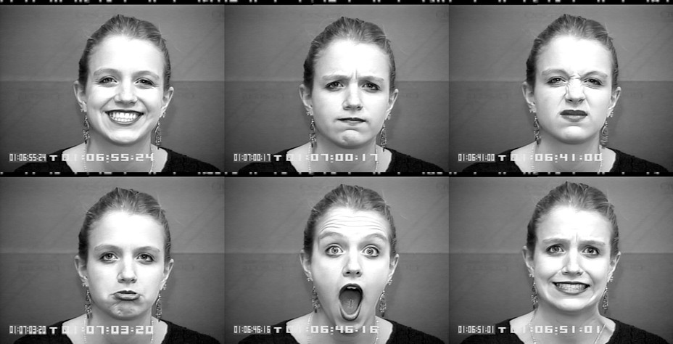
Comparison of Facial Expression Classification Model Architectures
PATTERN RECOGNITION COMP 6731
Gurleen Pannu (40289625), Saketh Oppula (40221013), Thuhin Khanna (40271685)

Slide 2
INTRODUCTION
Facial expression recognition (FER) is a fascinating and challenging field within computer vision, aimed at enabling machines to interpret human emotions based on facial expressions.
Convolutional Neural Networks (CNNs), with their ability to automatically and adaptively learn spatial hierarchies of features from facial images, have set new benchmarks in this domain.
We delve into various CNN architectures. These include more advanced systems like ResNet.
Moreover, we explore the critical aspect of preprocessing in FER. Preprocessing techniques like Face Detection, Normalization, Histogram Equalization and Noise Reduction are crucial for improving the performance of CNNs in FER. They help in reducing the variability in the input data and focusing the learning process on the essential features relevant to expression recognition.
This presentation aims to provide an insightful overview of these developments and their implications in the field of computer vision and beyond.

Slide 3
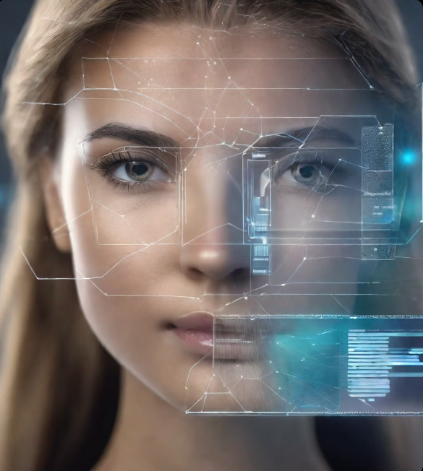
MOTIVATION
Facial expression recognition has become increasingly important in fields such as psychology, marketing, and security.
However, traditional methods for recognizing facial expressions are limited in their accuracy and efficiency.
With the advancements in deep learning and convolutional neural networks (CNNs), there is an opportunity to improve upon these traditional methods and develop more accurate and efficient models for facial expression recognition.

Slide 4
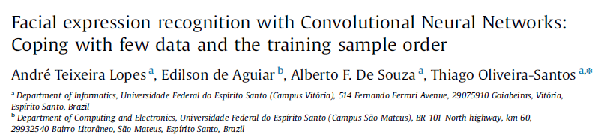
OVERVIEW OF THE RESEARCH PAPER
The paper proposes a simple solution to the Facial Expression Recognition which includes a combination of Convolutional Neural Network (CNN) and specific image preprocessing steps that include – Rotation Correction, Image Cropping, Resizing the Image and Intensity Normalization.
The dataset used includes the CK+, JAFFE and BU-3DFE datasets, and the model achieves an accuracy of 96.76% on the CK+ dataset.

Slide 5
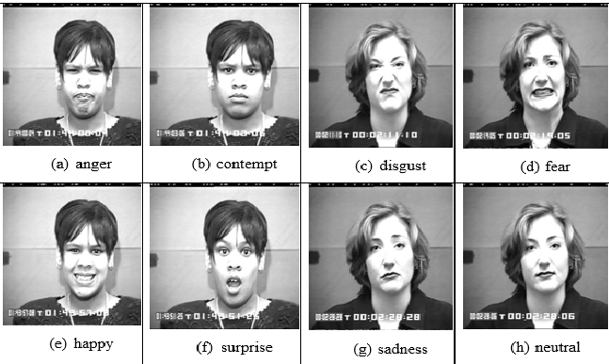
DATASET – CK+
The CK+ dataset comprises 100 university students with age between 18 and 50 years old. The subjects in the dataset are 65% female, 15% are African-American and 3% are Asian or South American.
All images in the database are 640X480 pixel arrays with 8-bit precision for grayscale values.
The various expressions captured include:

Slide 6
METHODOLOGY

Slide 7
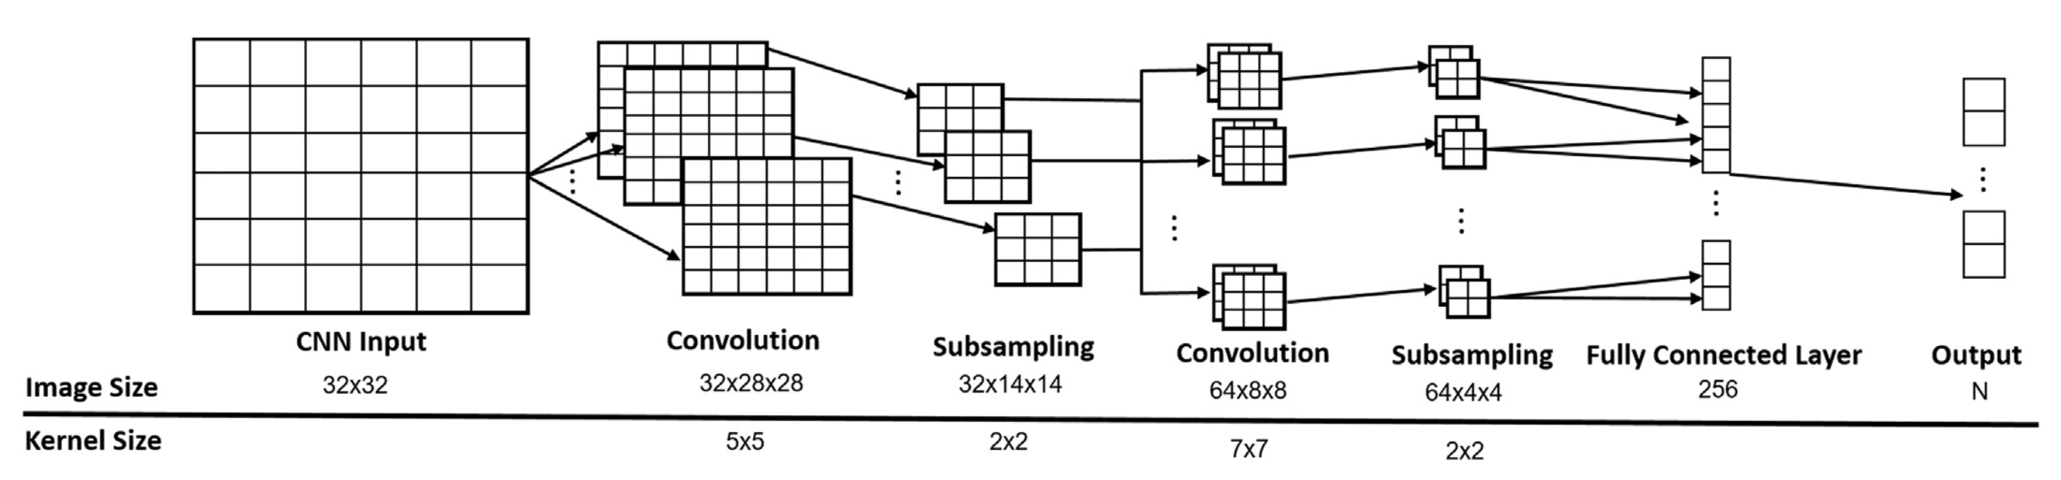
CONVOLUTIONAL MODEL
The Convolutional model for classifying facial expressions consists of three convolutional layers and two sub-sampling layers (Max Pooling) with the Activation function ReLU.
The final decision layer is a Dense layer of 7 neurons representing each of the seven emotions represented in the dataset. A dropout layer is also present that removes half the node in the penultimate layer.
The model is trained with a k-fold cross-validation of 5 splits since the amount of data available to us from the dataset is limited.
Image from A.T. Lopes et al. Facial expression recognition with Convolutional Neural Networks: Coping with few data and the training sample order, 2017

Slide 8
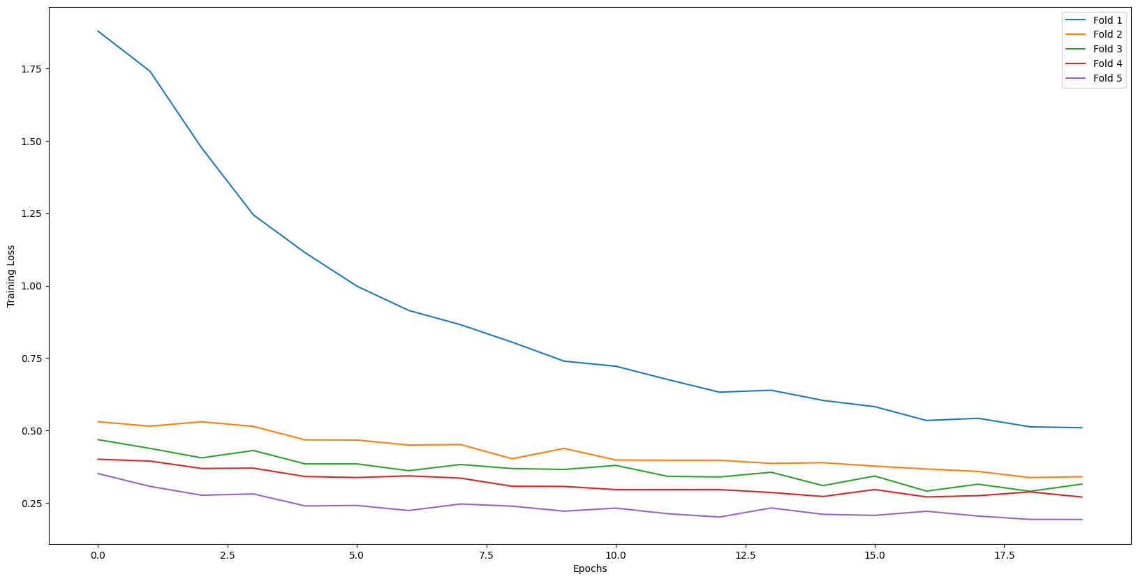
CONVOLUTIONAL MODEL
The resultant model in a testing accuracy of 92.38% in the test dataset.
Plot depicting the loss function in each fold of training

Slide 9
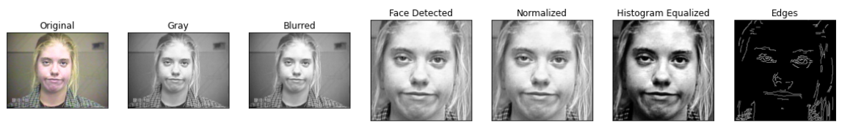
DATA PRE-PROCESSING
Data preprocessing is a critical step in the machine learning pipeline, and involves transforming raw data into an understandable format, making it more suitable for building and training models.
The following Pre-processing techniques were applied on our dataset:
Conversion to Grayscale
Noise Reduction with Gaussian Blur
Face Detection
Normalization
Histogram Equalization
Edge Detection

Slide 10
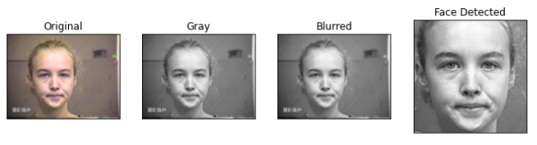
DATA PRE-PROCESSING
Conversion to Grayscale: Simplifies the image by reducing it to a single channel. This is particularly useful in tasks where color may not provide significant additional information.
Noise Reduction with Gaussian Blur: Smoothes the image to reduce noise and details, which helps in reducing the complexity of the image analysis and improving the performance of face detection.
Face Detection: Identifies and locates faces within the image. This is crucial as it focuses the analysis on the relevant part of the image. After detecting the face, cropping ensures that subsequent processing and analysis are focused solely on the facial region.

Slide 11
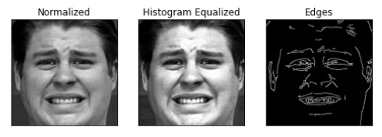
DATA PRE-PROCESSING
Normalization: Scales pixel values to a standard range, often 0 to 1. This helps in standardizing the input for the model and can improve convergence during training.
Histogram Equalization: Enhances the contrast of the image, making features more distinguishable and potentially improving model performance.
Edge Detection: Identifies and highlights the edges within the facial region. This can be beneficial in emphasizing facial features, which are crucial in expression recognition.

Slide 12
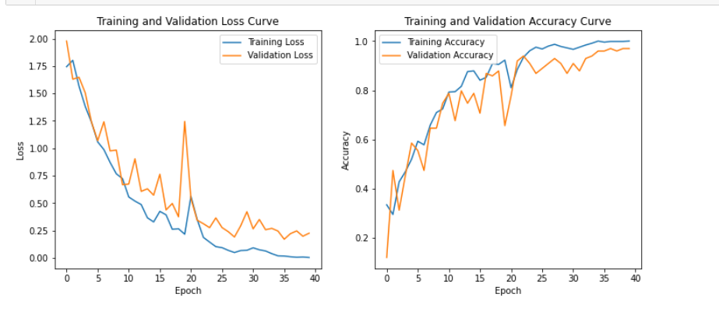
RESNET
ResNet is a state-of-the-art model in computer vision that has a wide range of applications in large datasets of images. ResNet’s complex architectures enable it to capture intricate patterns in the data on which it is trained.
Using ResNet with the CK+ dataset resulted in a better accuracy of about 98.6%

Slide 13
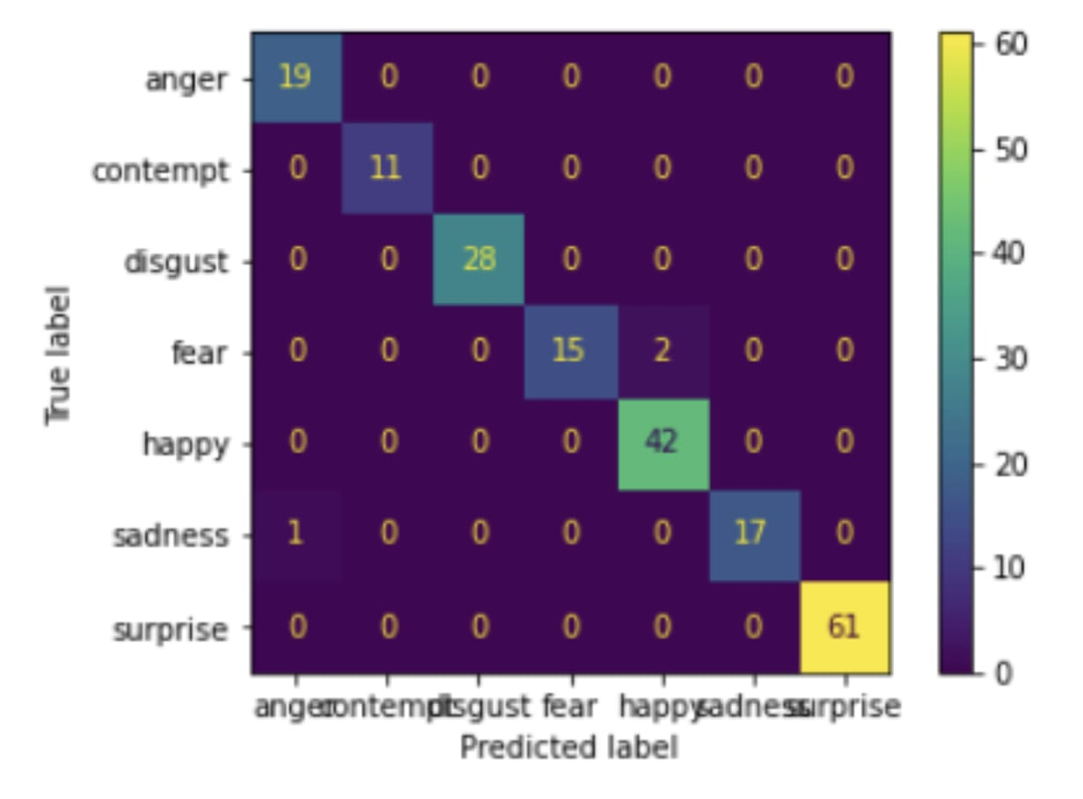
RESNET

Slide 14
RESULTS
Preprocessing Comparison
Our project show that using preprocessing techniques like Histogram Equalization, Gaussian Blurring, and Canny Edge Detection as a preprocessing method improves the facial expression recognition accuracy compared to other methods such as Rotation and Down Sampling as done in the research paper referred.
Architecture Comparison
We could also see that the ResNet architecture outperforms the other CNN architectures in achieving a nuanced and better facial expression recognition accuracy.

Slide 15
CONCLUSION
Through our research on facial expression recognition with CNNs, we have found that the choice of architecture and preprocessing methods can greatly impact the accuracy of the model.
We have explored various architectures such as VGG, ResNet, and Inception, and found that each has its own strengths and weaknesses.
Additionally, we have experimented with preprocessing techniques such as data augmentation and normalization, and found that these can also greatly improve the performance of the model.

Slide 16
FUTURE SCOPE
Data Augmentation: Exploring more advanced data augmentation techniques such as Mix-up, Cutout, Color Jittering and Elastic Transformations to further improve the models performance.
Transfer Learning: Investigating the effectiveness of transfer learning by fine-tuning pre-trained models such as VGG16 and ResNet50 on our dataset.
Gathering datasets with large amounts of images available in order to further enhance the accuracy and prediction of the model.

Slide 17
REFERENCES
Andr Teixeira Lopes, Edilson de Aguiar, A. F. De, and Thiago Oliveira-Santos, “Facial expression recognition with Convolutional Neural Networks: Coping with few data and the training sample order,” Pattern Recognition, vol. 61, pp. 610–628, Jan. 2017, doi: https://doi.org/10.1016/j.patcog.2016.07.026.
B. Li and D. Lima, “Facial expression recognition via ResNet-50,” International Journal of Cognitive Computing in Engineering, vol. 2, pp. 57–64, Jun. 2021, doi: https://doi.org/10.1016/j.ijcce.2021.02.002.
B. Mandal, A. Okeukwu, and Y. Theis, “Masked Face Recognition using ResNet-50,” Apr. 2021. Available: https://arxiv.org/pdf/2104.08997.pdf
A. Luiz, Leandro, and A. Conci, “Image preprocessing techniques for facial expression classification,” Jun. 2022, doi: https://doi.org/10.5753/lique.2022.19995.‌

